Slide 1
Indexing Structures
Database Design
Chapter 17

Slide 2
Indexes as Access Paths
A single-level index is an auxiliary file that makes it more efficient to search for a record in the data file
The index is usually specified on one field of the file (although it could be specified on several fields)
One form of an index is a file of entries <field value, pointer to record>, which is ordered by field value
The index is called an access path on the field

Slide 3
Indexes as Access Paths
The index file usually occupies considerably fewer disk blocks than the data file because its entries are much smaller
A binary search on the index yields a pointer to the file record
Indexes can also be characterized as dense or sparse
A dense index has an index entry for every search key value (and hence every record) in the data file.
A sparse (or nondense) index, on the other hand, has index entries for only some of the search values

Slide 4
Indexes as Access Paths
Example: Given the following data file EMPLOYEE(NAME, SSN, ADDRESS, JOB, SAL, ... )
Suppose that:
record size R=150 bytes block size B=512 bytes r=30000 records
Then, we get:
blocking factor Bfr= B div R= 512 div 150= 3 records/block
number of file blocks b= (r/Bfr)= (30000/3)= 10000 blocks

Slide 5
Indexes as Access Paths
For an index on the SSN field, assume the field size V_{SSN}=9 bytes, assume the record pointer size P_{R}=7 bytes. Then:
index entry size R_{I}=(V_{SSN}+ P_{R})=(9+7)=16 bytes
index blocking factor Bfr_{I}= B div R_{I}= 512 div 16= 32 entries/block
number of index blocks b= (r/ Bfr_{I})= (30000/32)= 938 blocks
binary search needs log₂bI= log₂938= 10 block accesses
This is compared to an average linear search cost of:
(b/2)= 30000/2= 15000 block accesses
If the file records are ordered, the binary search cost would be:
log₂b= log₂30000= 15 block accesses
Notes:
Contrived example. Record pointers are nearly always 8 bytes.

Slide 6
Types of Single-Level Indexes
Primary Index
Defined on an ordered data file
The data file is ordered on a key field
Includes one index entry for each block in the data file; the index entry has the key field value for the first record in the block, which is called the block anchor
A similar scheme can use the last record in a block
A primary index is a nondense (sparse) index, since it includes an entry for each disk block of the data file and the keys of its anchor record rather than for every search value

Slide 7
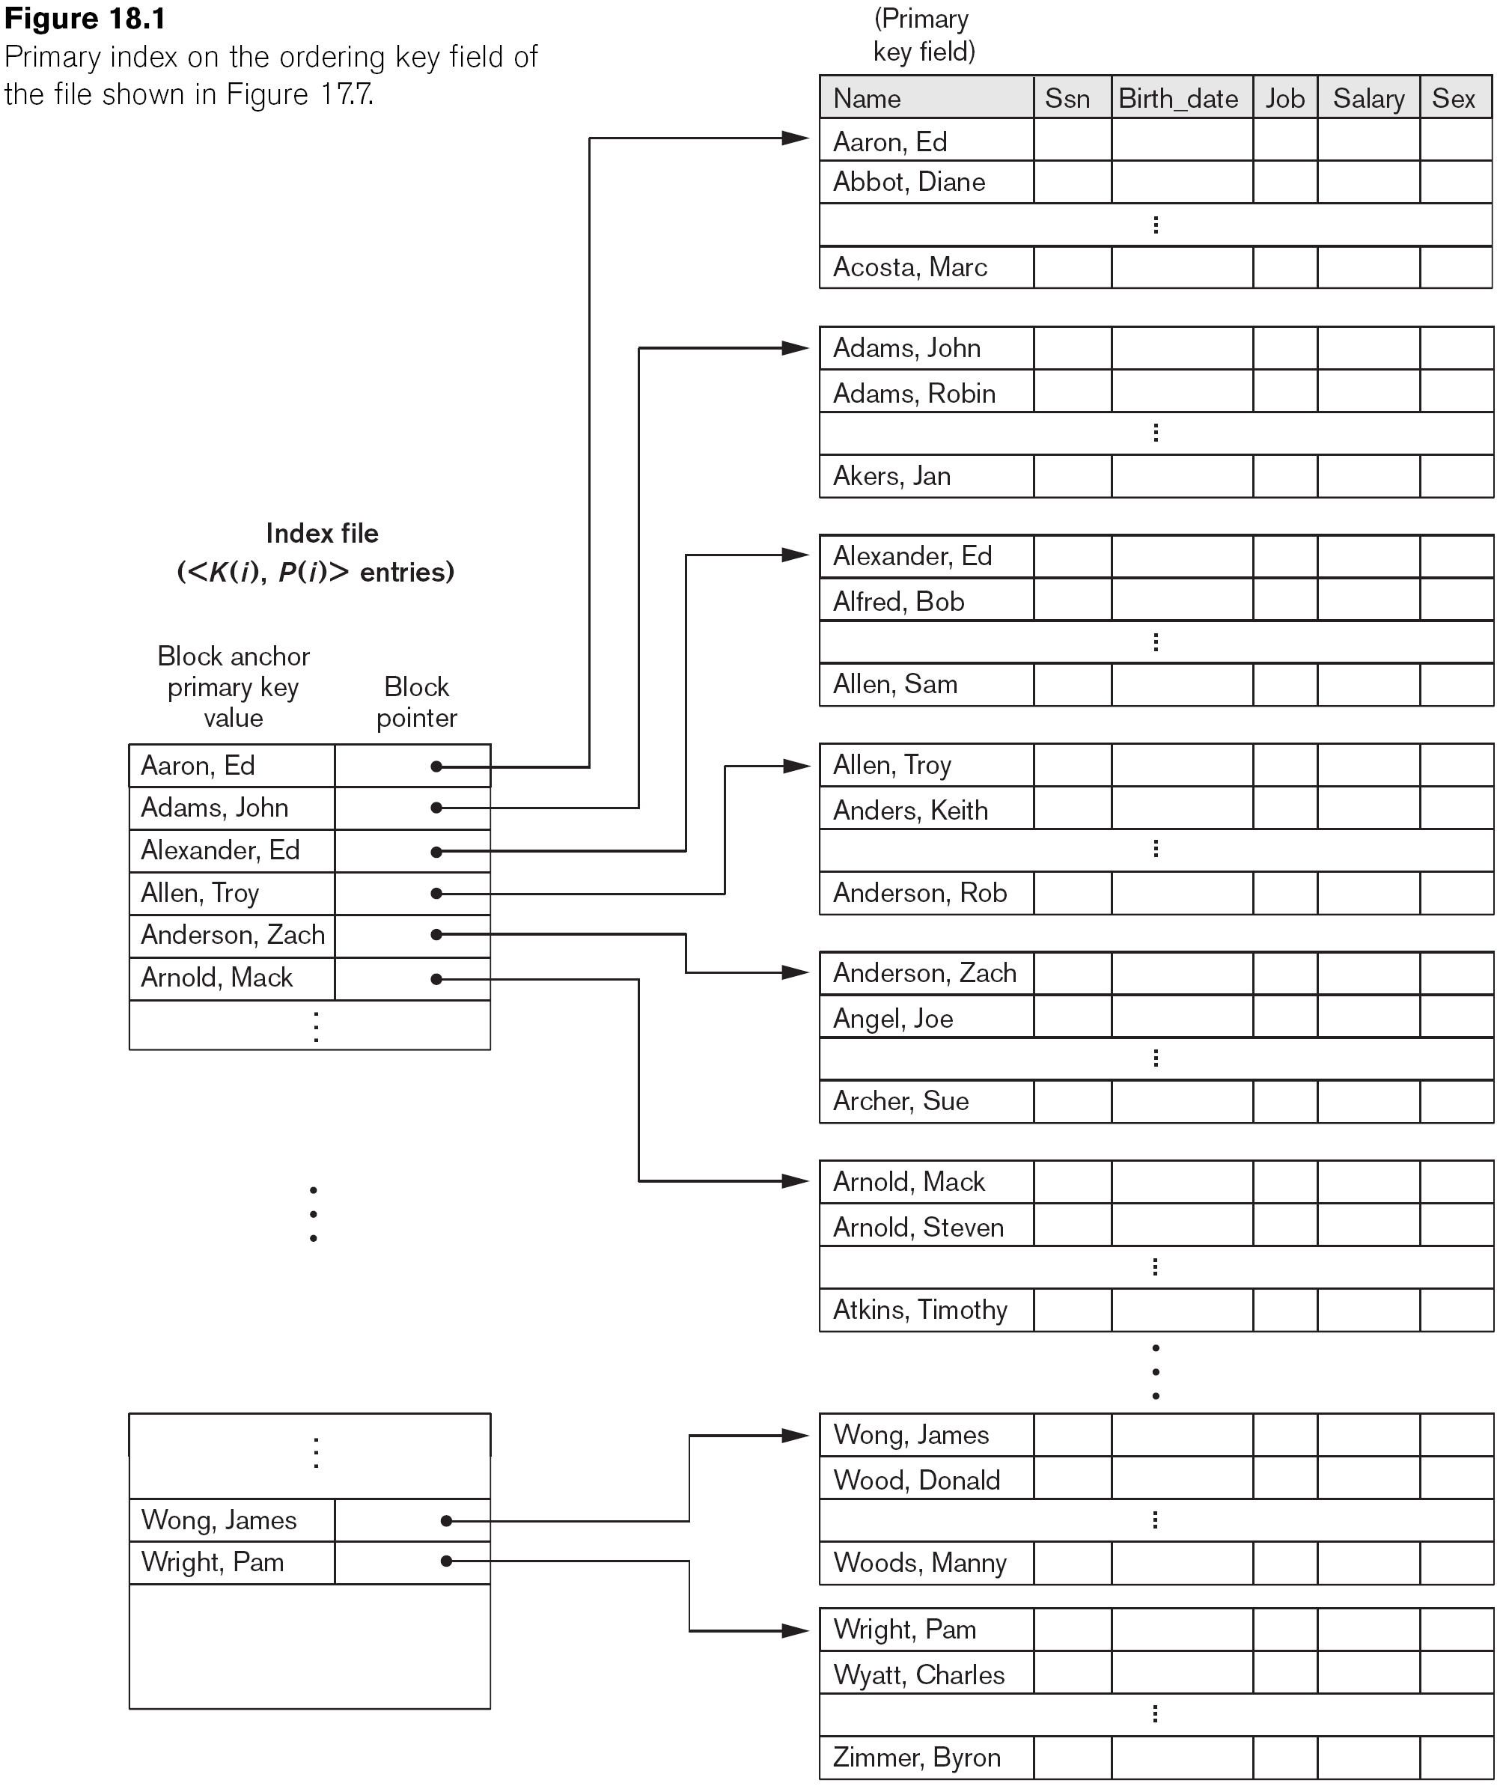
Primary Index on the Ordering Key Field

Slide 8
Types of Single-Level Indexes
Clustering Index
Defined on an ordered data file
The data file is ordered on a non-key field unlike primary index, which requires that the ordering field of the data file have a distinct value for each record
Includes one index entry for each distinct value of the field; the index entry points to the first data block that contains records with that field value
It is another example of nondense index where Insertion and Deletion is relatively straightforward with a clustering index

Slide 9
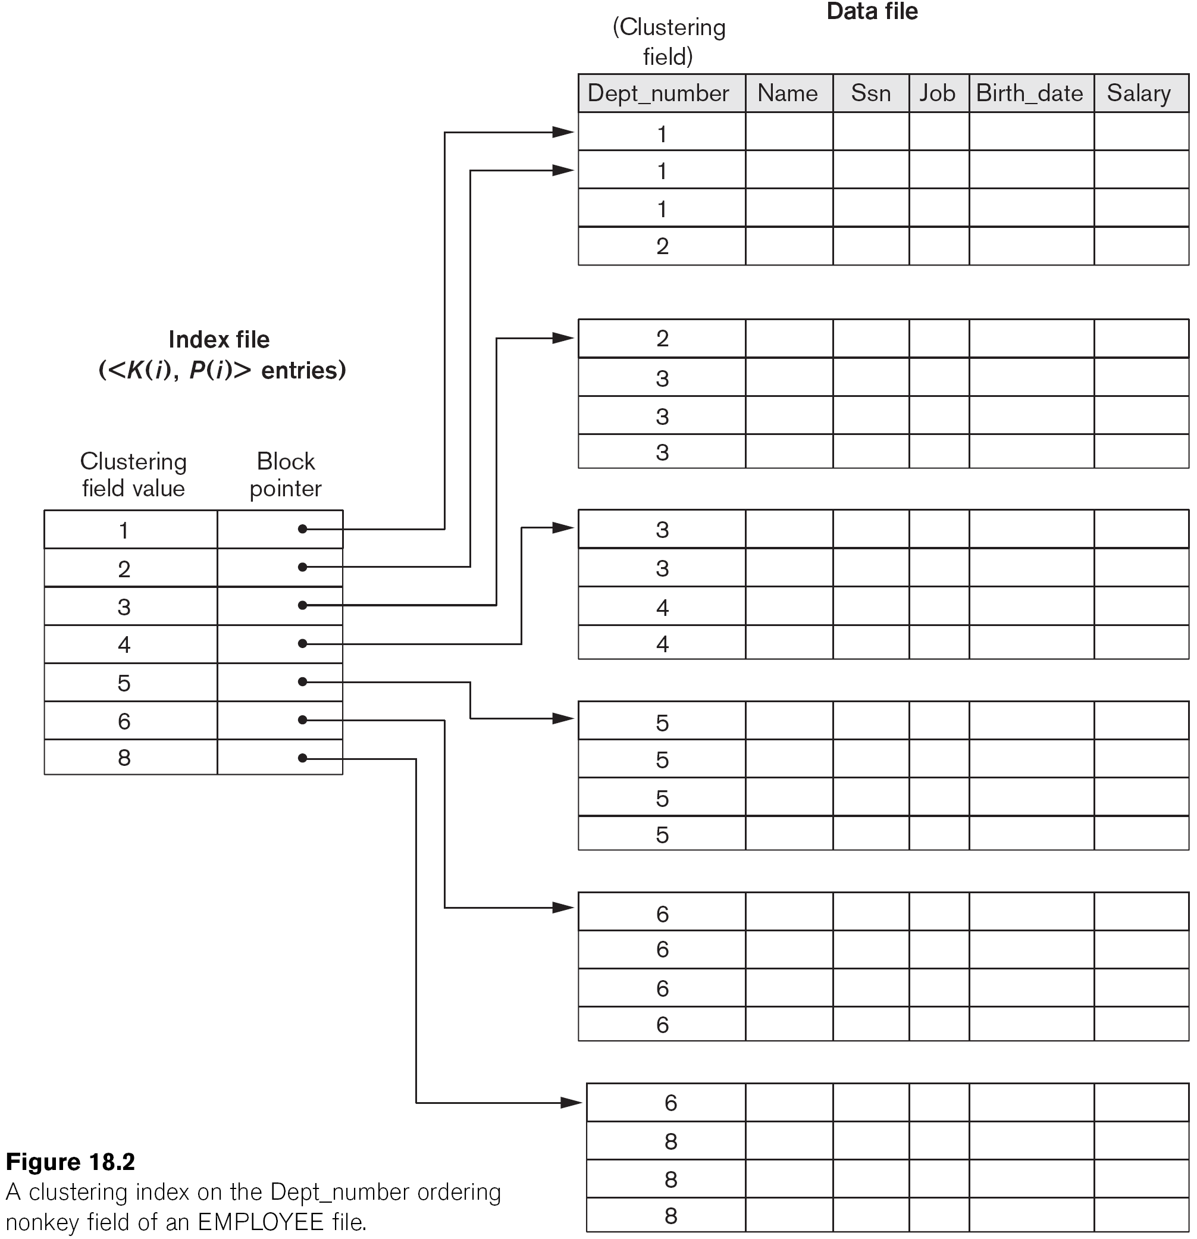
A Clustering Index Example

Slide 10
Another Clustering Index Example

Slide 11
Types of Single-Level Indexes
Secondary Index
A secondary index provides a means of accessing a file for which some primary access already exists.
The secondary index may be on a field which is a candidate key and has a unique value in every record, or a non-key with duplicate values.
The index is an ordered file with two fields.
The first field is of the same data type as some non-ordering field of the data file that is an indexing field.
The second field is either a block pointer or a record pointer.
There can be many secondary indexes (and hence, indexing fields) for the same file.
Includes one entry for each record in the data file; hence, it is a dense index

Slide 12
Example of a Dense Secondary Index

Slide 13
Example of a Secondary Index

Slide 14
Properties of Index Types

Slide 15
Multi-Level Indexes
Because a single-level index is an ordered file, we can create a primary index to the index itself
In this case, the original index file is called the first-level index and the index to the index is called the second-level index
We can repeat the process, creating a third, fourth, ..., top level until all entries of the top level fit in one disk block
A multi-level index can be created for any type of first-level index (primary, secondary, clustering) as long as the first-level index consists of more than one disk block

Slide 16
A Two-Level Primary Index

Slide 17
Multi-Level Indexes
Such a multi-level index is a form of search tree
However, insertion and deletion of new index entries is a severe problem because every level of the index is an ordered file

Slide 18
Searching Non-Dense Multilevel Index
p <- Address of top-level index block
For j <- t step -1 to 1 do
Begin
Read the index block (at j^{th} index level) whose address is p
Search block p for entry i such that K_{j} (i) <= K < K_{j}(i+1)
// If K_{j}(i) is the last entry in the block it satisfies this condition
P <- P_{j}(i)
End
Read the data block whose address is p
Search block p for record with key = K

Slide 19
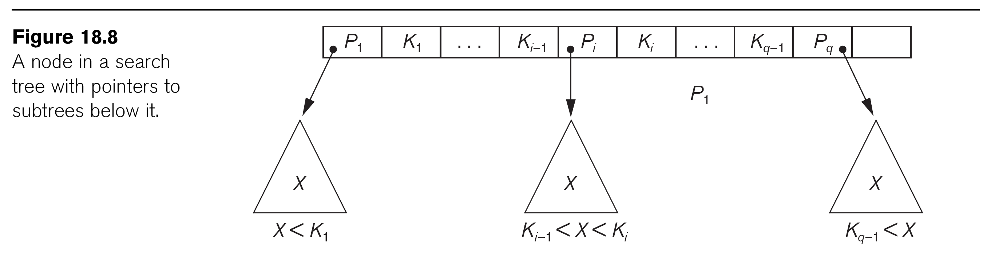
A Node in a Search Tree with Pointers to Subtrees Below It

Slide 20
Dynamic Multilevel Indexes Using B-Trees and B+-Trees
Most multi-level indexes use B-tree or B+-tree data structures because of the insertion and deletion problem
This leaves space in each tree node (disk block) to allow for new index entries
These data structures are variations of search trees that allow efficient insertion and deletion of new search values
In B-Tree and B+-Tree data structures, each node corresponds to a disk block
Each node is kept between half-full and completely full

Slide 21
Dynamic Multilevel Indexes Using B-Trees and B+-Trees
An insertion into a node that is not full is quite efficient
If a node is full the insertion causes a split into two nodes
Splitting may propagate to other tree levels
A deletion is quite efficient if a node does not become less than half full
If a deletion causes a node to become less than half full, it must be merged with neighboring nodes

Slide 22
Difference Between B-tree and B+-tree
In a B-tree, pointers to data records exist at all levels of the tree
In a B+-tree, all pointers to data records exists at the leaf-level nodes
A B+-tree can have less levels (or higher capacity of search values) than the corresponding B-tree

Slide 23
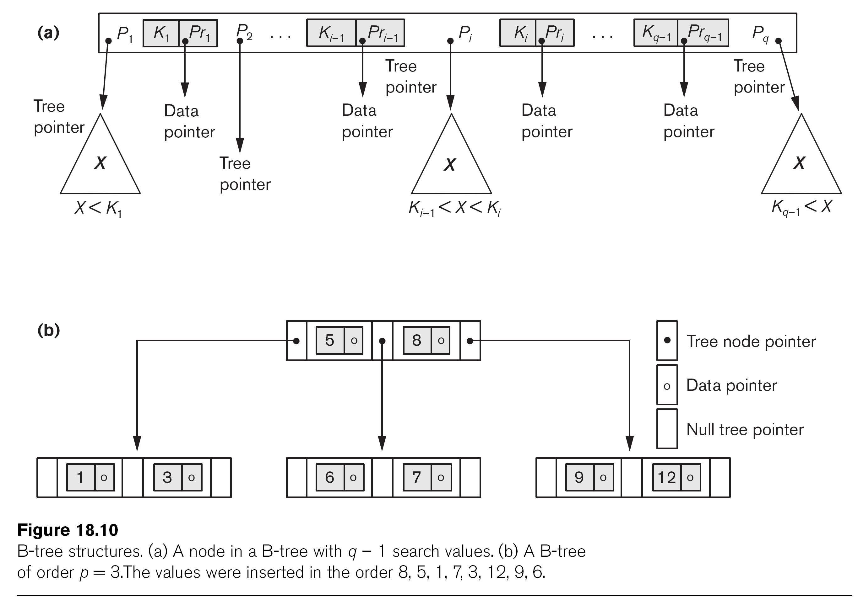
B-Tree Structures

Slide 24
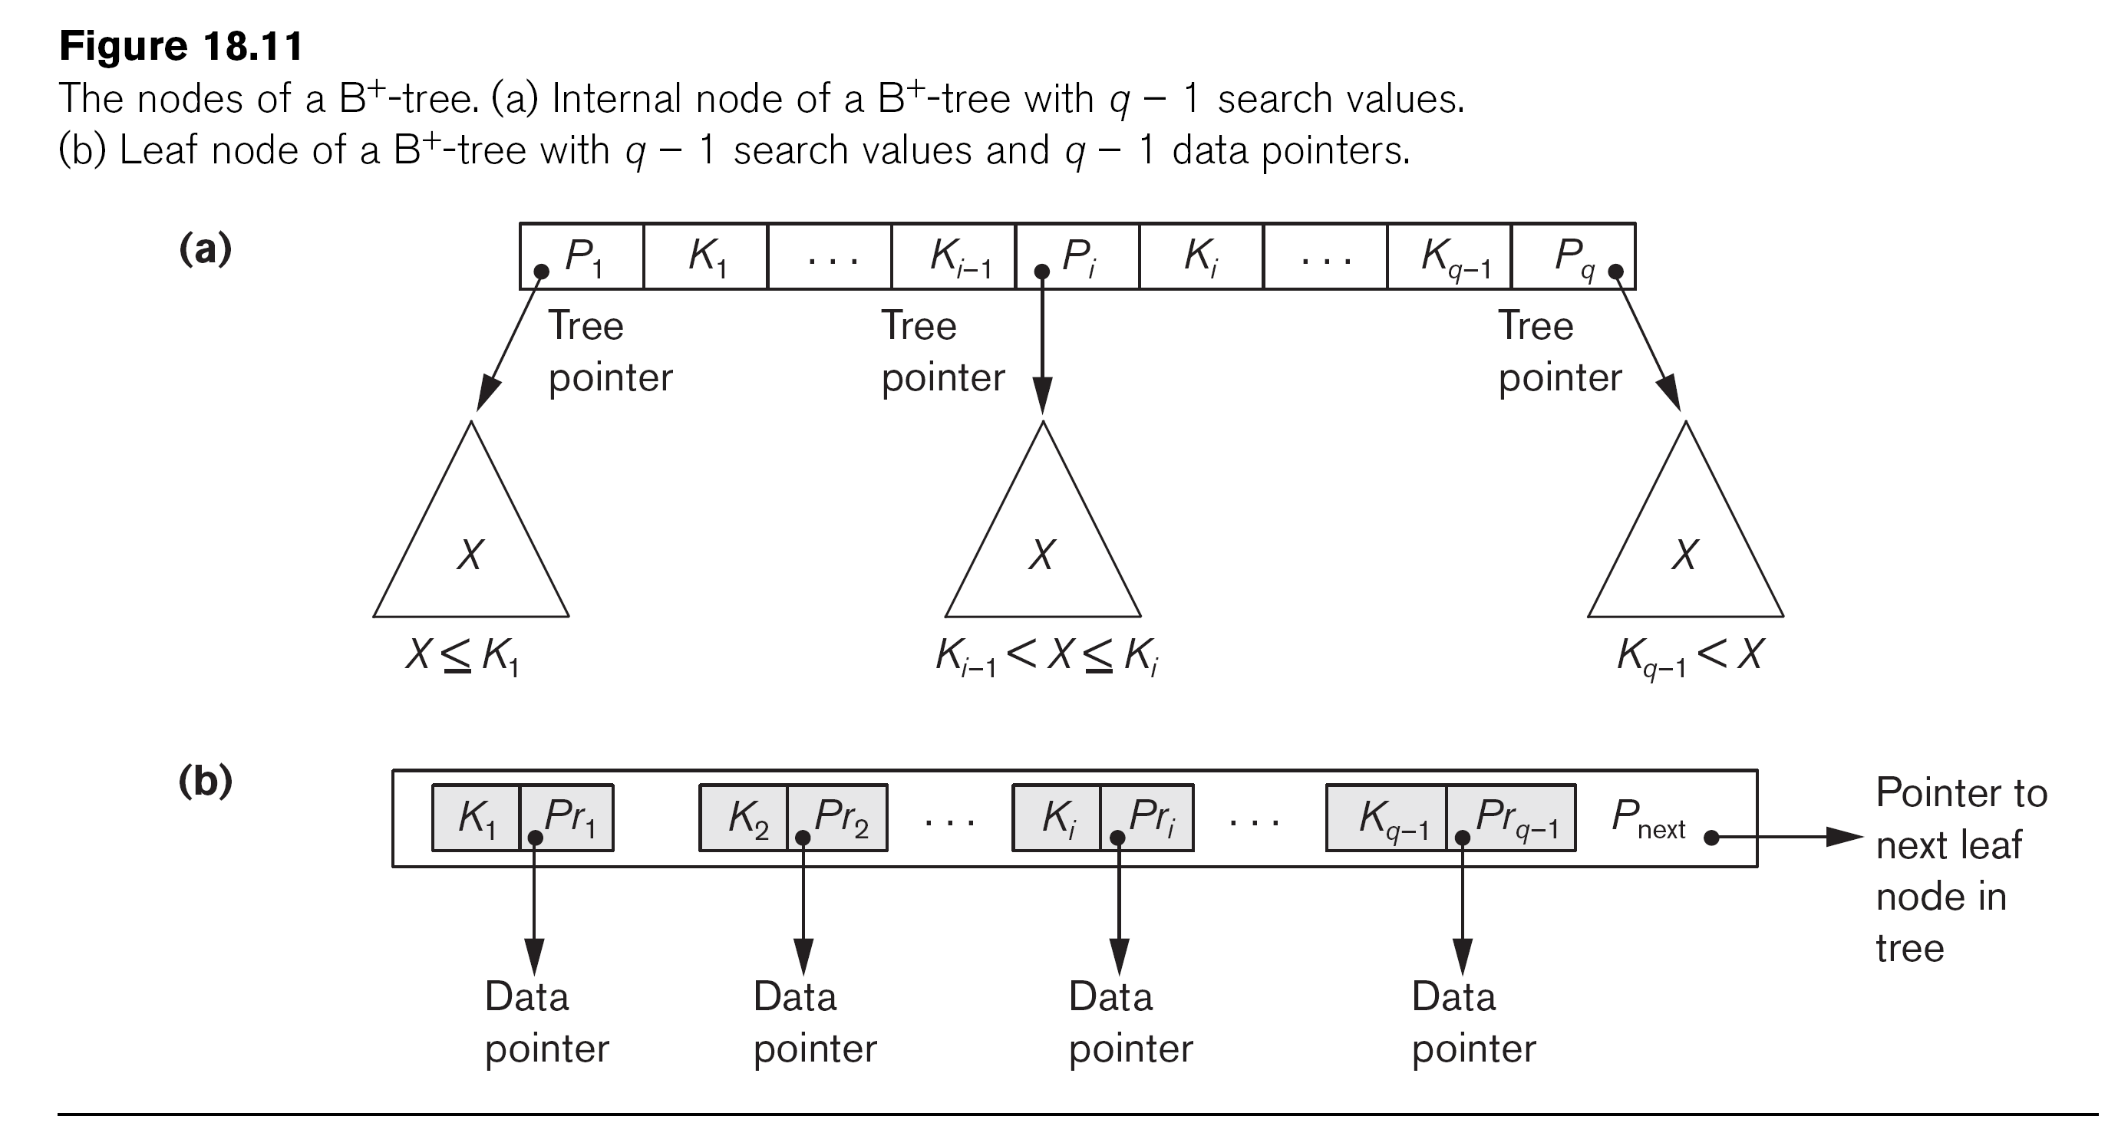
The Nodes of a B+-tree

Slide 25
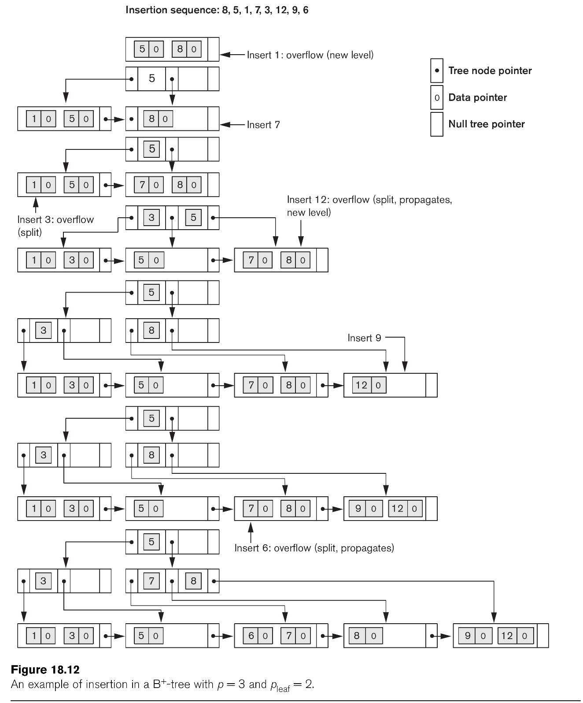
Example of an Insertion in a B+-tree

Slide 26
Deletion in a B+ Tree
Notes:
Animation of insert/delete: https://www.youtube.com/watch?v=UQxHh2Mpwno
Animation applet: https://www.cs.usfca.edu/~galles/visualization/BPlusTree.html

Slide 27
Summary
Types of Single-level Ordered Indexes
Primary Indexes
Clustering Indexes
Secondary Indexes
Multilevel Indexes
Dynamic Multilevel Indexes Using B-Trees and B+-Trees
Indexes on Multiple Keys

